Slide 1



knya
View in Power BI
mayanksingh2518@gmail.com
Last data refresh:
1/10/2024 7:42:40 PM UTC
Downloaded at:
1/10/2024 7:43:23 PM UTC

Slide 2
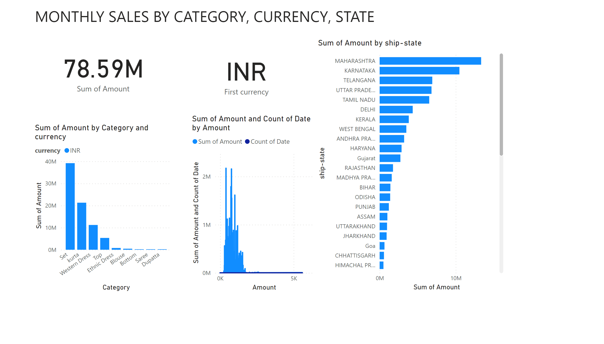
Page 1
Notes:
textbox
No alt text provided
textbox
No alt text provided
clusteredColumnChart
No alt text provided
areaChart
No alt text provided
card
No alt text provided
card
No alt text provided
clusteredBarChart
No alt text provided

Slide 3
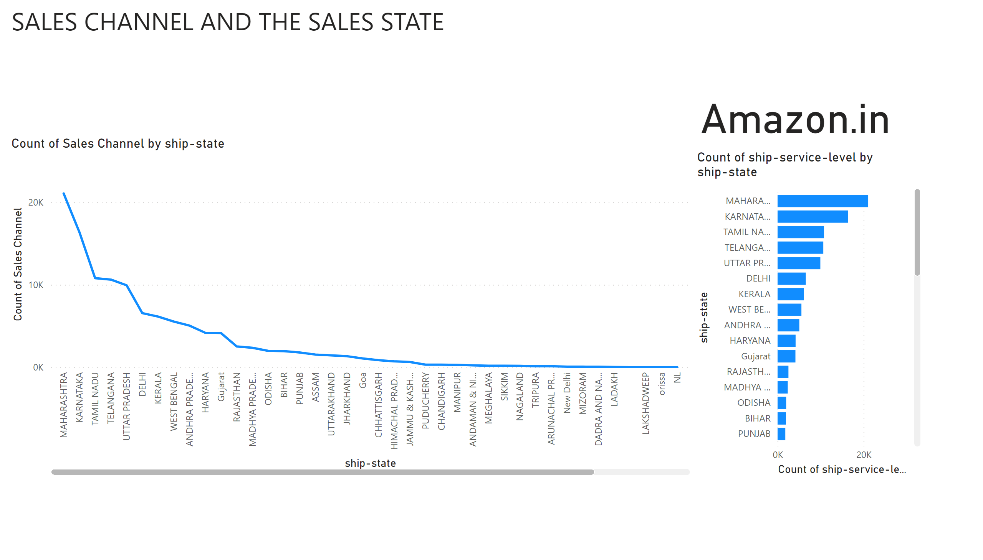
Page 2
Notes:
textbox
No alt text provided
lineChart
No alt text provided
card
No alt text provided
clusteredBarChart
No alt text provided

Slide 4
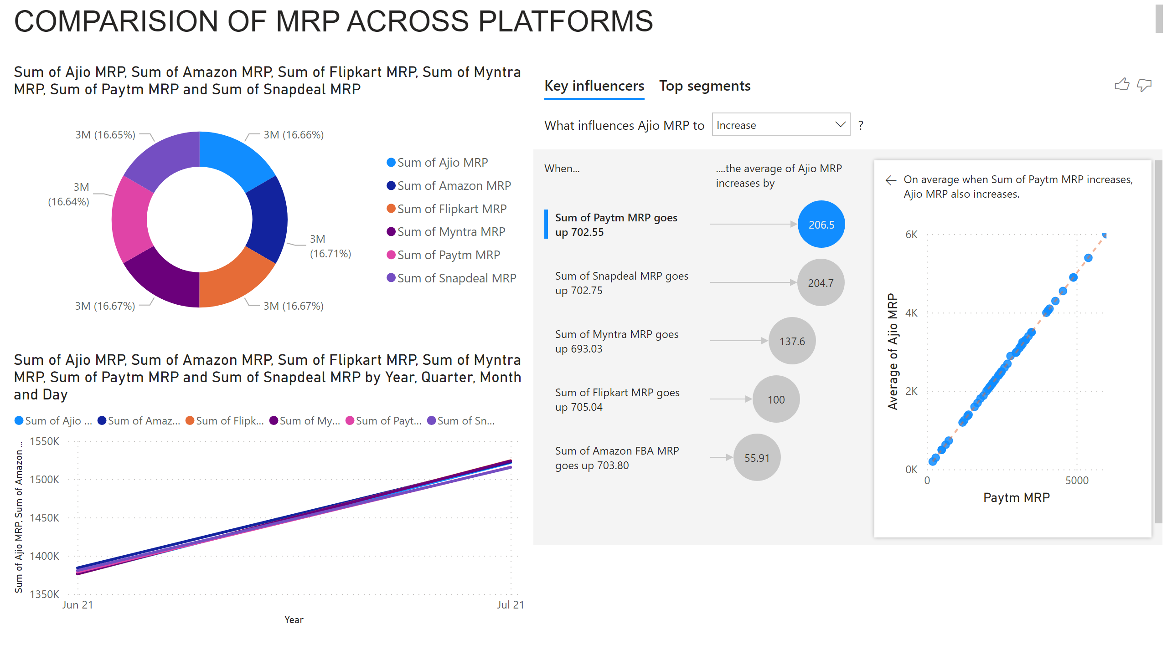
Page 3
Notes:
textbox
No alt text provided
donutChart
No alt text provided
lineChart
No alt text provided
keyDriversVisual
No alt text provided

Slide 5
COST CUTTING IN THE DELIVERY
Reducing delivery costs requires a strategic approach that maintains service quality while optimizing expenses.
Here are several cost-cutting measures you can consider
Optimize Delivery Routes : Use route optimization software to plan the most efficient delivery routes, minimizing fuel consumption and time .
Consolidate deliveries to reduce the number of trips and optimize vehicle capacity .
Utilize Technology : Implement GPS tracking systems to monitor and manage delivery routes in real-time, ensuring drivers follow the most efficient paths.
Explore autonomous or semi-autonomous delivery options to reduce labor costs . Collaborate with Third-Party Logistics (3PL) Providers: Outsource delivery services to third-party logistics companies that specialize in efficient and cost-effective transportation solutions .
Flexible Delivery Options : Offer flexible delivery windows to consolidate orders and reduce the number of trips . Introduce options like slower or off-peak delivery for cost-conscious customers.
Provided the data set the INCREFF comes an handy and profitable inventory and delivery firm.

Slide 6
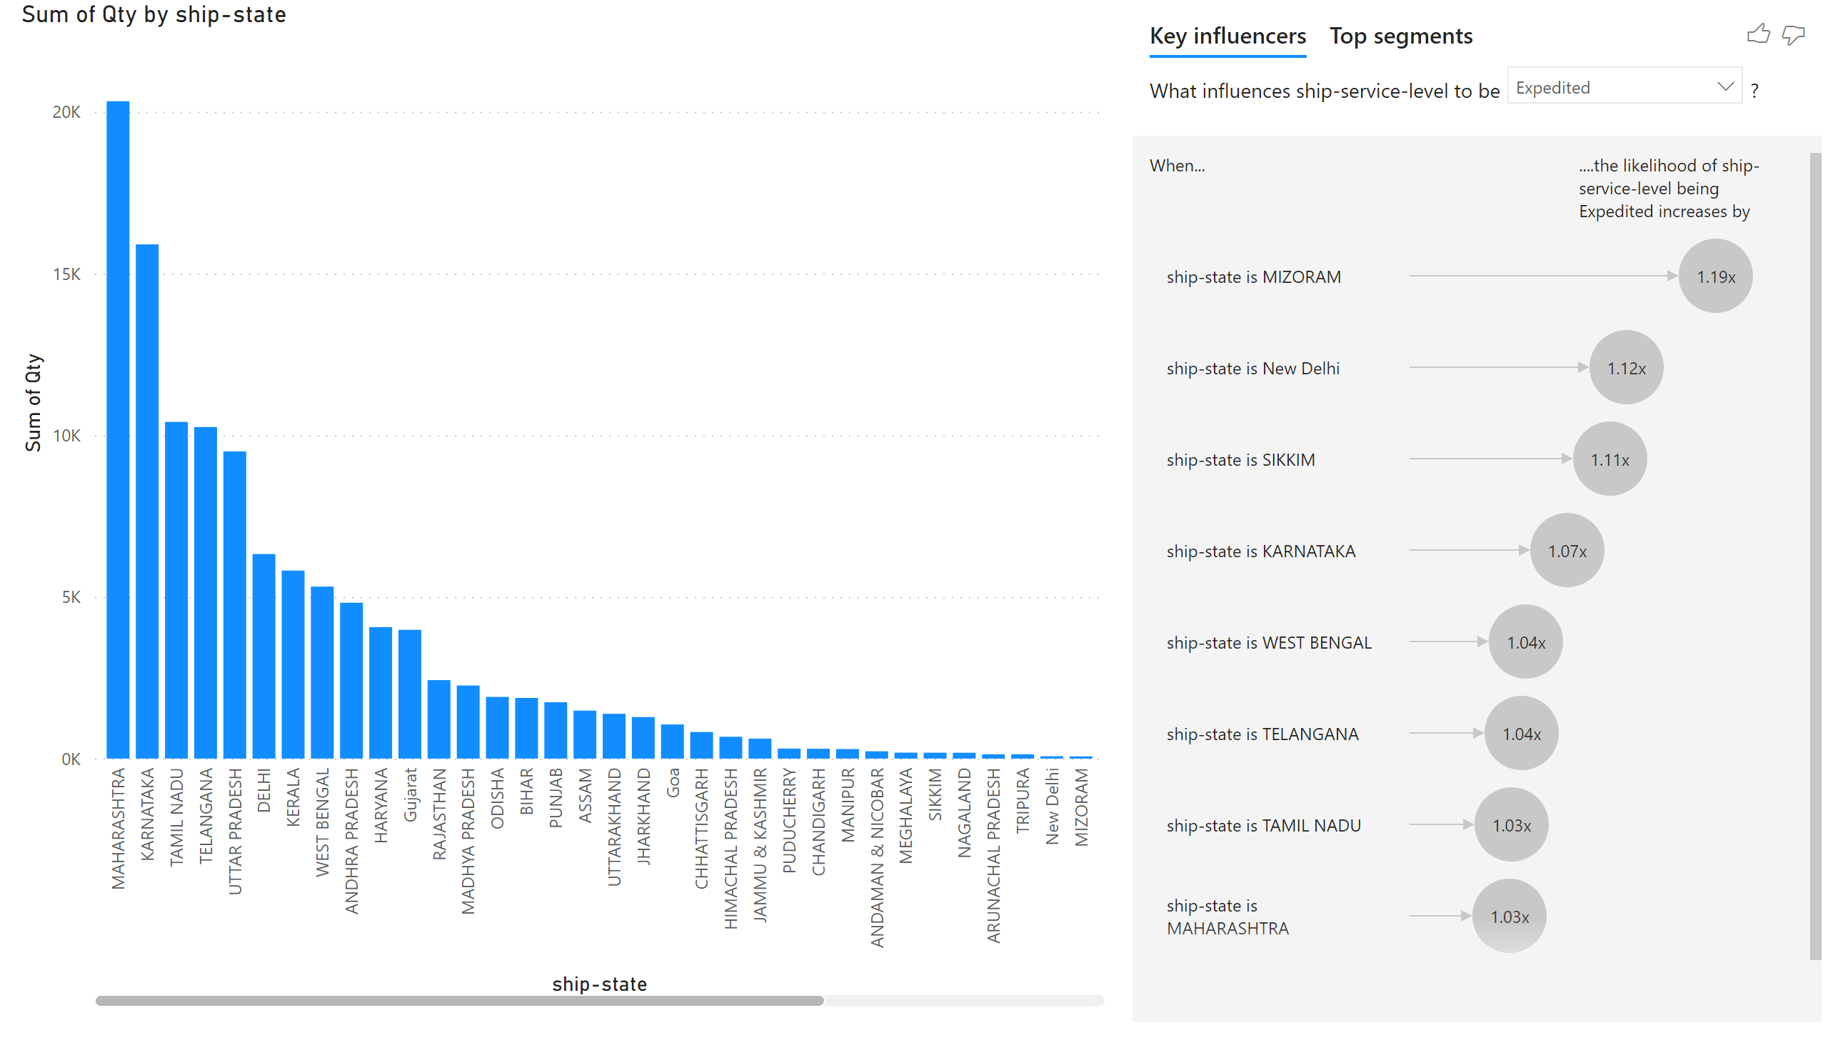
Page 5
Notes:
clusteredColumnChart
No alt text provided
keyDriversVisual
No alt text provided

Slide 7
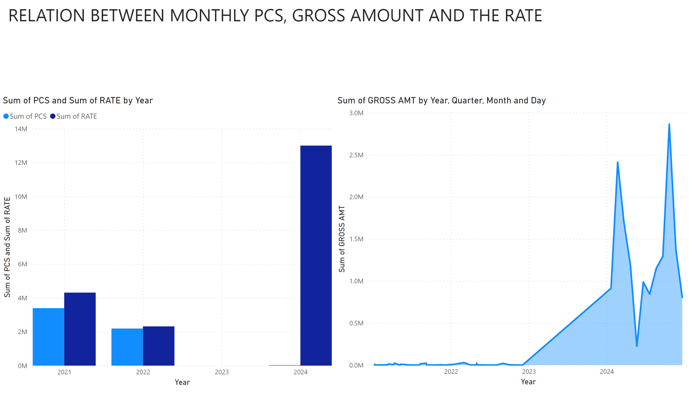
Page 4
Notes:
textbox
No alt text provided
clusteredColumnChart
No alt text provided
textbox
No alt text provided
stackedAreaChart
No alt text provided

Slide 8
THANK YOU

